Slide 1

Hospital Emergency Room Analysis Dashboard
This presentation outlines the development of a Microsoft Excel designed to enhance efficiency and provide actionable insights within a hospital emergency room. The dashboard aims to empower stakeholders with the ability to monitor key performance indicators (KPIs), analyze trends, and make informed decisions to improve patient care and resource allocation. By visualizing critical data, the dashboard will contribute to streamlined operations and a better patient experience.

Slide 2

Number of Patients & Daily Trends
This visual tracks the total number of patients visiting the ER each day, offering crucial insights into patient volume and demand. A line chart is an effective way to identify patterns, such as busy days or seasonal trends, enabling proactive resource planning. For instance, a spike in patients during flu season can prompt increased staffing levels and supply procurement. This will help you handle any unexpected scenarios during your interview.
500
Daily Average
Typical patient visits
750
Peak Days
High-volume days

Slide 3
Average Wait Time Analysis
This is where you measure the average time patients wait to see a medical professional in the ER. Longer wait times often lead to dissatisfaction, potentially impacting patient outcomes and hospital reputation. By promptly addressing longer wait times, hospitals can enhance patient satisfaction and improve overall care. This will help you handle any unexpected scenarios during your interview.
Monitor Daily Fluctuations
Identify Improvement Areas
Highlight days with longer wait times.
Pinpoint bottlenecks in the ER process.

Slide 4






Patient Satisfaction Score
This calculates the average daily satisfaction score of patients to gauge service quality in the ER. Consistently high satisfaction scores reflect efficient processes and positive patient interactions. A high satisfaction score is indicative of a well-managed ER and a positive patient experience, reflecting positively on the hospital's reputation.
Detect Trends
Identify drops in satisfaction
Evaluate Satisfaction
Daily patient satisfaction scores
Correlate Challenges
Potential issues

Slide 5
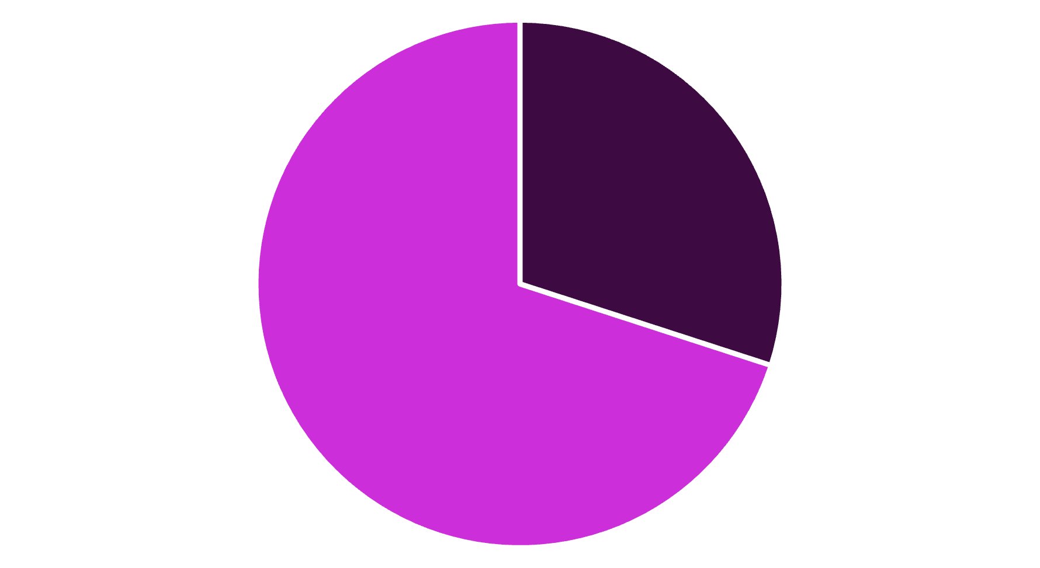
Patient Admission Status
Here we visualize how many patients were admitted versus those not admitted from the ER. This helps understand the severity of cases and the demand for hospital beds. Use a pie chart or bar graph to display this data effectively, providing a clear visual representation of admission rates. This analysis aids in predicting resource needs and improving hospital bed management.
Admitted
Not Admitted

Slide 6
Patient Demographics & Referrals
Here we have 2 subtopics, both very important. Patient Age Distribution groups patients by age, providing insights into the demographics of ER visitors. Gender Analysis displays the number of patients by gender, offering a balanced view. Displaying the number of patients by gender aids in understanding population-specific healthcare needs.
Patient Age Distribution
Gender Analysis
Understand ER visitor demographics
Display number of patients by gender
Group patients by age ranges
Analyze potential gender-specific patterns

Slide 7

Key Takeaways & Next Steps
The ER Analysis Dashboard offers a comprehensive solution for improving efficiency and patient care. This provides hospital administrators and ER staff with actionable insights. By implementing the dashboard and regularly reviewing its visualizations, hospitals can proactively address challenges. Next Steps: Implement the Power BI dashboard with real-time data integration and conduct staff training to ensure effective use.
1
Implement Dashboard
2
Train Staff
Integrate data
Ensure effective use
3
Review Visualizations
Take action

